Slide 1
Tv Channel Database Management
Roll:1505071
1505072

Slide 2
Contents :
ERD Diagram with Chen Notation Symbols
Entities
Types of Attributes
Relationship
Connectivity and Cardinalities
Summary

Slide 3
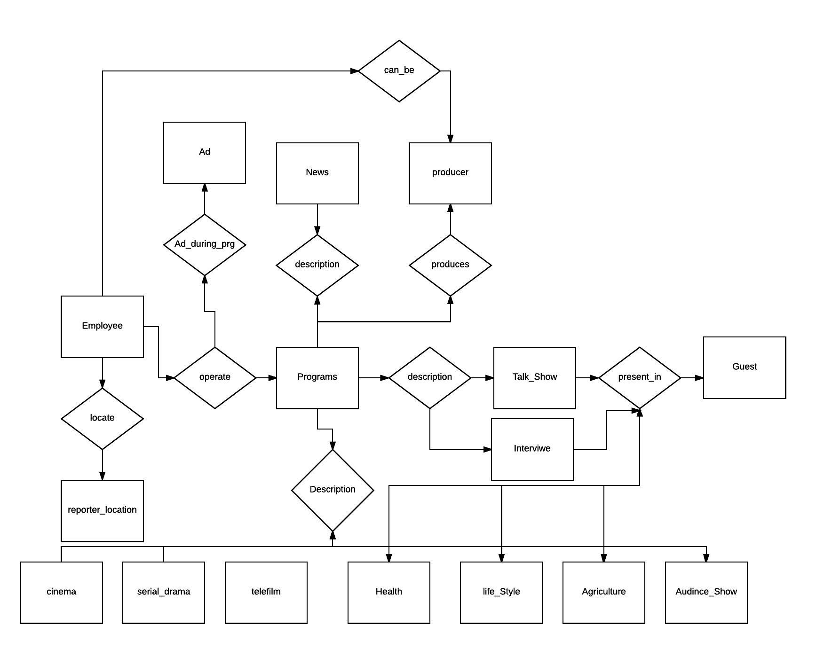

Slide 4
News
-News_Reader
-EmployeeId(id)
-Starting_time
-End_time
-TRP
-Advertise
-Date
-Camera_man
-Makeup_Man
-news_Hour
-Director_name
-Producer_Name
-prgrm_TypeId(id)
-Cycle
Reality_show
-Show_id(id)
-Prgrm_name
- -------
Programs
-prgrm_Id(id)
-EmployeeId(id)
Serials
-Serial_Name
-Serial_Id(id)
- --------
Employees
-Employees_Name
-Employees_id(id)
-Salary
-Job_type
-Job_id
-Hire_date
-Retirement_Date
-COMMISSION_PCT, -Mobile_no
-Address
Talk Show
-TT_TypeId(id)
-TT_name
- ---------

Slide 5
Serials
-Serial_name
-Serial_type
-Prgrm_TypeId(fk)
-Serial_id(pk)
-Producer
-Director
-Employee_id
-TRP
-Starting_time
-End_Time
-Starting_Date
-End_Date
Advertisement
-Product_name
-Product_id(pk)
-Slot
-Sponsor_fee
Casting
-Performer_name
-Performer_id
-Casting_fee

Slide 6
Advertisement
-Product_name
-Product_id(pk)
-Slot
-Sponsor_fee
Serials
-Serial_name
-Serial_type
-Serial_id(pk)
-Producer
-Director
-Employee_id
-TRP
-Starting_time
-End_Time
-Starting_Date
-End_Date
Ad_during_prg
-Product_id(pk)
-prgrm_Id(fk)
Casting
-member_name
-member_id
-Employee_id
-Casting_fee
-Designation
-Serial_id
Cast
-member_id
-prgrm_id

Slide 7
Advertisement
-Product_name
-Product_id(pk)
-Slot
-Sponsor_fee
Talk_Show
-TT_name
-TT_type
-TT_id(pk)
-Producer
-Director
-Employee_id
-TRP
-Starting_time
-End_Time
-Starting_Date
-End_Date
Ad_during_prg
-Product_id(pk)
-prgrm_Id(fk)
Guest
-guest_name
-guest_id
-Employee_id
-guest_Honourium
-Designation
-TT_id
-Mobile
-Email
-Address
Cast
-member_id
-prgrm_id

Slide 8
Advertisement
-Product_name
-Product_id(pk)
-Slot
-Sponsor_fee
Others
-Prg_name
-Prg_type
-Prg_id(pk)
-Producer
-Director
-Employee_id
-TRP
-Starting_time
-End_Time
-Starting_Date
-End_Date
Ad_during_prg
-Product_id(pk)
-prgrm_Id(fk)
Casting
-member_name
-member_id
-Employee_id
-Casting_fee
-Designation
-Serial_id
Cast
-member_id
-prgrm_id

